Slide 1
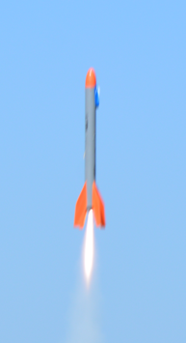
Analytical Model
Thrust
Weight
Drag

Slide 2
Background and Objective
As discussed earlier, the “core” of OpenRocket are models that can be replicated in Excel.
We will use Excel to estimate the performance of your rocket and compare this to OpenRocket and test data.

Slide 3
Rocket Performance Basis
The basis of the rocket performance is Newton’s second law:
F = ma
The objective is to determine acceleration, velocity and height of the rocket.
The steps will be outlined here; see reference Excel workbook for details.

Slide 4
Rocket Acceleration
To determine acceleration, rearrange Newton's second law equation:
a = F/m
The mass of the rocket can readily be determined:
m = Wg
Where W is weight and g is the acceleration due to gravity; g = 9.81 m/s (SI)

Slide 5
Forces Acting on a Rocket - Ascent
Force | Direction | Comments
Weight | Down | Weight is reduced as fuel is combusted.
Drag | Down | Drag acts in direction opposite of velocity.
Thrust | Up | Thrust varies with time.
Velocity
Thrust
Powered; motor operating
Unpowered; after motor burn-out. Rocket will continue to gain altitude until reaching apogee.
Weight
Drag

Slide 6
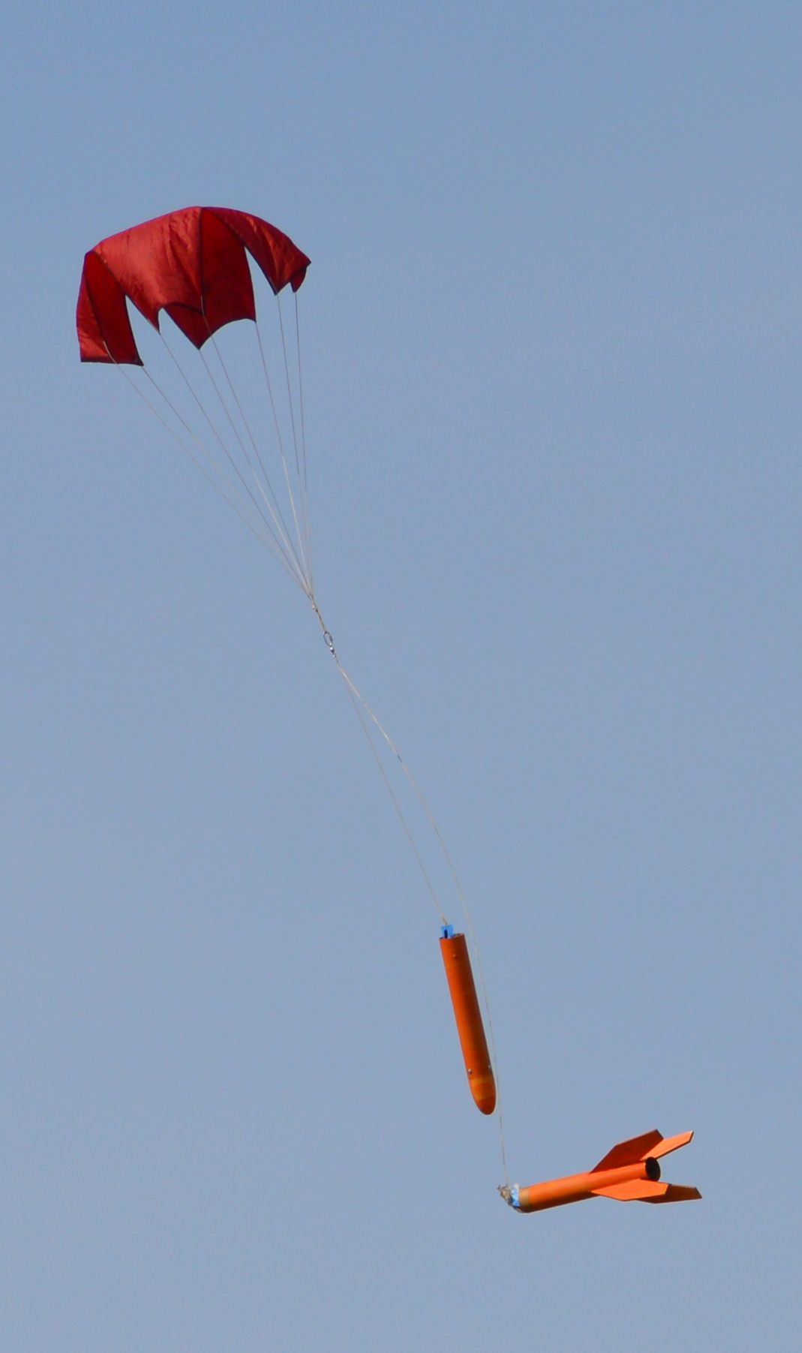
Forces Acting on a Rocket - Decent
Force | Direction | Comments
Weight | Down | Weight is constant.
Drag | Up | Drag acts in direction opposite of velocity.
Drag
Velocity
Weight
Parachute greatly increases drag.
Shortly after deploying parachute, rocket will descend at a near constant velocity
Drag
Weight

Slide 7
Thrust and Mass
Thrust is available from the motor manufacturer.
The rocket’s mass can be measured and should be close to the OpenRocket predicted value.

Slide 8

Aerodynamic Drag
Drag is calculated using the following equation:
C_{d} = drag coefficient. This is a function of object shape.
For this rocket C_{d} = 0.45
ρ = Air density
V = Velocity
A = Cross sectional area of rocket
$$Drag=C_{d}\frac{1}{2}ρV2A$$

Slide 9
Excel Calculation
To determine your rocket’s performance, the flight will be divided into a series of small time steps
For each time increment, assume constant force & mass (and therefore acceleration) the governing equations are:
a = F/m
Δv = at
Δy = y₀ + v₀t + ½at²
Apply the change in velocity and position to the next time increment.
Recalculate the acceleration for the next time increment based on the thrust at that time and find the next increment of velocity and position.
Continue until the rocket reaches apogee.

Slide 10
SSR Model Comparisons

Slide 11
Performance Calculations
Calculation Type | Variable Thrust | Aerodynamic Drag | Propellant Mass Change | Secondary Effects | Variability and Anomalies
Hand
Excel, 1 | X
Excel, 2 | X | X
OpenRocket | X | X | X | X
Test Data (Actual Data) | X | X | X | X | X
Secondary effects include: Wind, launch angle, flight angle and others.
Variability effects include: Wind gusts, motor-to-motor differences, ignition and others

Slide 12
Summary of Models
If drag is neglected then apogee will be over predicted.
If thrust is assumed constant, apogee may be over or under predicted; it depends on the thrust characteristic.
Including variable thrust and drag will yield results very close to OpenRocket.
“Real World” factors such as cross wind, non-vertical small launch angle or weathervaning will reduce the ideal performance. OpenRocket can model many of these factors.

Slide 13
Class Exercise
Using Excel, estimate the apogee of your rocket.
Compare this estimate with
OpenRocket
Test Data

